Slide 1
Spatial Planning and Land Use Management Act PHA / Centre for Environmental Rights / Centre of Excellence on Food Security
Jaap de Visser
31 August 2017
Jaap de Visser
31 August 2017

Slide 2
Spatial Planning and Land Use Management Act (SPLUMA)
What does it do?
What does it not do?

Slide 3
History of SPLUMA
1994 | 1995 | 2000 |  | 2010 | 2013
…apartheid planning laws
….4 provincial ordinances

Slide 4
History of SPLUMA
1994 | 1995 | 2000 |  | 2010 | 2013
…apartheid planning laws | DFA (tribunals) | Systems Act (IDP)
….4 provincial ordinances

Slide 5
History of SPLUMA
1994 | 1995 | 2000 |  | 2010 | 2013
…apartheid planning laws | DFA (tribunals) | Systems Act (IDP)
….4 provincial ordinances
 |  |  |  | CC strikes DFA down

Slide 6
History of SPLUMA
1994 | 1995 | 2000 |  | 2010 | 2013
…apartheid planning laws | DFA (tribunals) | Systems Act (IDP) |  |  | SPLUMA
….4 provincial ordinances
 |  |  |  | CC strikes DFA down

Slide 7
History of SPLUMA
1994 | 1995 | 2000 |  | 2010 | 2013
…apartheid planning laws | DFA (tribunals) | Systems Act (IDP) |  |  | SPLUMA
….4 provincial ordinances
 |  |  |  | CC strikes DFA down
Who does what?
.

Slide 8
DFA (2010) | Maccsands (2012) | Lagoon Bay (2013) | Habitat (2014) Pieterse (2016) | Tronop (2015)

Slide 9
DFA (2010) | Maccsands (2012) | Lagoon Bay (2013) | Habitat (2014) Pieterse (2016) | Tronop (2015)
Can province take ‘town planning’ decisions?

Slide 10
DFA (2010) | Maccsands (2012) | Lagoon Bay (2013) | Habitat (2014) Pieterse (2016) | Tronop (2015)
Can province take ‘town planning’ decisions?
No, municipality takes town planning decisions (rezoning & township development)

Slide 11
DFA (2010) | Maccsands (2012) | Lagoon Bay (2013) | Habitat (2014) Pieterse (2016) | Tronop (2015)
Can province take ‘town planning’ decisions? | Does a national approval make municipal approval unnecessary?
No, municipality takes town planning decisions (rezoning & township development)

Slide 12
DFA (2010) | Maccsands (2012) | Lagoon Bay (2013) | Habitat (2014) Pieterse (2016) | Tronop (2015)
Can province take ‘town planning’ decisions? | Does a national approval make municipal approval unnecessary?
No, municipality takes town planning decisions (rezoning & township development) | No, municipality must still take decision

Slide 13
DFA (2010) | Maccsands (2012) | Lagoon Bay (2013) | Habitat (2014) Pieterse (2016) | Tronop (2015)
Can province take ‘town planning’ decisions? | Does a national approval make municipal approval unnecessary? | Can province overrule municipality when development is ‘bigger than the municipality’?
No, municipality takes town planning decisions (rezoning & township development) | No, municipality must still take decision

Slide 14
DFA (2010) | Maccsands (2012) | Lagoon Bay (2013) | Habitat (2014) Pieterse (2016) | Tronop (2015)
Can province take ‘town planning’ decisions? | Does a national approval make municipal approval unnecessary? | Can province overrule municipality when development is ‘bigger than the municipality’?
No, municipality takes town planning decisions (rezoning & township development) | No, municipality must still take decision | No, municipality must still take decision

Slide 15
DFA (2010) | Maccsands (2012) | Lagoon Bay (2013) | Habitat (2014) Pieterse (2016) | Tronop (2015)
Can province take ‘town planning’ decisions? | Does a national approval make municipal approval unnecessary? | Can province overrule municipality when development is ‘bigger than the municipality’? | Can province be appeal body?
No, municipality takes town planning decisions (rezoning & township development) | No, municipality must still take decision | No, municipality must still take decision

Slide 16
DFA (2010) | Maccsands (2012) | Lagoon Bay (2013) | Habitat (2014) Pieterse (2016) | Tronop (2015)
Can province take ‘town planning’ decisions? | Does a national approval make municipal approval unnecessary? | Can province overrule municipality when development is ‘bigger than the municipality’? | Can province be appeal body?
No, municipality takes town planning decisions (rezoning & township development) | No, municipality must still take decision | No, municipality must still take decision | No, appeal from municipal to province is unconstitutional

Slide 17
DFA (2010) | Maccsands (2012) | Lagoon Bay (2013) | Habitat (2014) Pieterse (2016) | Tronop (2015)
Can province take ‘town planning’ decisions? | Does a national approval make municipal approval unnecessary? | Can province overrule municipality when development is ‘bigger than the municipality’? | Can province be appeal body? | When provincial appeal is independent expert body?
No, municipality takes town planning decisions (rezoning & township development) | No, municipality must still take decision | No, municipality must still take decision | No, appeal from municipal to province is unconstitutional

Slide 18
DFA (2010) | Maccsands (2012) | Lagoon Bay (2013) | Habitat (2014) | Tronop (2015)
Can province take ‘town planning’ decisions? | Does a national approval make municipal approval unnecessary? | Can province overrule municipality when development is ‘bigger than the municipality’? | Can province be appeal body? | When provincial appeal is independent expert body?
No, municipality takes town planning decisions (rezoning & township development) | No, municipality must still take decision | No, municipality must still take decision | No, appeal from municipal to province is unconstitutional | No, appeal to province is still unconstitutional

Slide 19
SPLUMA’s Architecture of Laws
At least two, possibly three layers of law
SPLUMA (+ regulations)
(some) provincial planning laws
E.g. KZN, WCape, NCape
municipal by-laws

Slide 20
SPLUMA’s Development Principles
spatial justice
e.g. impact on land value can’t stop a decision
expand planning system, include informal settlements, former homeland areas etc.
spatial sustainability
protect agricultural land
efficiency
spatial resilience
good administration
Q: what role will they play in decision making?

Slide 21
SPLUMA’s SDFs
SPLUMA
NSDF
PSDF
MSDF
RSDF (optional)

Slide 22
SPLUMA’s SDFs
SPLUMA
Municipal Systems Act
NSDF
PSDF
MSDF
RSDF (optional)
SDF (part of IDP)

Slide 23
SPLUMA’s SDFs
SPLUMA
Municipal Systems Act
NSDF
PSDF
MSDF
RSDF (optional)
SDF (part of IDP)

Slide 24
SPLUMA’s SDFs
SPLUMA
Municipal Systems Act
NSDF
PSDF
MSDF
RSDF (optional)
SDF (part of IDP)
SDFs don’t give rights, schemes and land use decisions do
however, SPLUMA elevates MSDFs:
anyone taking land use decisions must follow MSDF, unless… ‘site specific circumstances…’
schemes must be consistent with MSDF

Slide 25
Why MSDF are important
SPLUMA says MSDFs must, for example:
estimate housing demand
identify location & density of future housing
identify areas for inclusionary housing
identify areas for incremental upgrading
identify areas for shortened land use development procedures

Slide 26
Municipality | Province | National
Council adopt by-law adopt scheme NB! > 5 yrs appoint Municipal Planning Tribunal NB! no cllrs
MPT or ‘designated official’ takes decision
Executive Mayor / Committee decides appeals

Slide 27
Municipality | Province | National
Council adopt by-law adopt scheme NB! > 5 yrs appoint Municipal Planning Tribunal NB! no cllrs | Legislature may (but does not have to) adopt provincial planning law
MPT or ‘designated official’ takes decision | Provincial Executive (if provincial law says so:) take additional decision if provincial interest affected
Executive Mayor / Committee decides appeals | monitor / support municipalities with SPLUMA

Slide 28
Municipality | Province | National
Council adopt by-law adopt scheme NB! > 5 yrs appoint Municipal Planning Tribunal NB! no cllrs | Legislature may (but does not have to) adopt provincial planning law | Minister regulations / guidelines
MPT or ‘designated official’ takes decision | Provincial Executive (if provincial law says so:) take additional decision if provincial interest affected | Minister takes additional decision / joins application if national interest affected
Executive Mayor / Committee decides appeals | monitor / support municipalities with SPLUMA | monitor / support municipalities with SPLUMA

Slide 29
LUPA
Only provincial law that is aligned with SPLUMA
Started ambitiously, ended with framework

Slide 30
Includes further Land Use Planning Principles
Further regulates PSDF, RSDFs, MSDFs
Minimum standards for municipal decision making, procedures
Gives further content to link between MSDF & land use management decisions
Regulates Provincial Land Use Management Decision making

Slide 31
Going forward
legal / institutional regime still incomplete
crucial:
next generation MSDFs - 2016-2021 IDPs
roll-out of municipal by-laws and land use schemes
role of traditional leaders?
uneven LG capability to implement
new orientation for provinces
from taking decisions → monitor/support (+ plan provincially)

Slide 32
Review of by-laws
relationship between by-law and provincial law?
link between municipal SDFs & land use management?
provisions on informality and insecure tenure arrangements?
provisions to combine approval processes?
provisions to address capacity challenges?

Slide 33
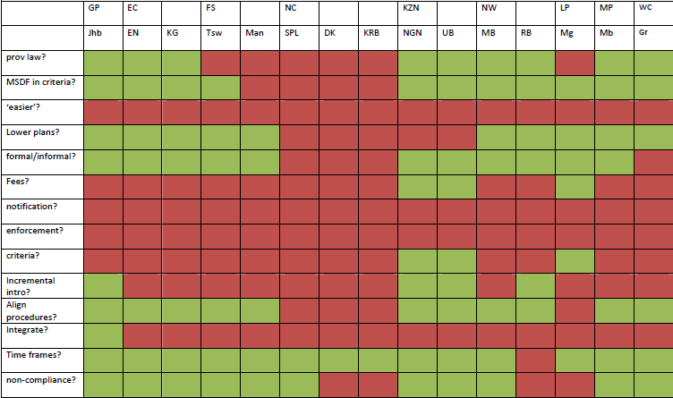

Slide 34
Thank you jdevisser@uwc.ac.za

